Slide 1
Epidemics and Networks

Slide 2

17.2 The SI Model
There are just two states, susceptible and infected.
An individual in the susceptible state is someone who does not have the disease yet but could catch it if they coming into contact with someone who does.
An individual in the infected state is someone who has the disease and can pass it on if they coming into contact with a susceptible individual.

Slide 3
The SI Model
Full-mixed (or mass-action) approximation:
Assume that every individual has an equal chance, per unit time, of coming into contact with every other.
Consider a disease spreading through a population of individuals by contact.
Let S(t) be the number of individuals who are susceptible at time t and let X(t) be the number who are infected.
For convenience, we just write S and X.
If the total population consists of n people, then S + X = n.

Slide 4
The SI Model
Transmission rate β: the expected number of people contact by a particular person per unit time.
The probability that a person you meet at random being susceptible at time t is S/n, and hence an infected person has contact with an average βS/n susceptible people per unit time.
Since there are X infected individuals at time t, the overall average rate of infection will be βSX/n.

Slide 5


Differential Equations for the SI Model
We can write differential equations for the rate of change of X and S respectively:
The mathematical model for the spread of disease is called the fully mixed susceptible-infected model, or SI model for short.

Slide 6
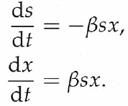


Logistic Growth Equation
Let s = S/n and x = X/n.
Hence s + x = 1 and
⇒
⇒
where x₀ is the value of x at t = 0.
Logistic growth equation

Slide 7
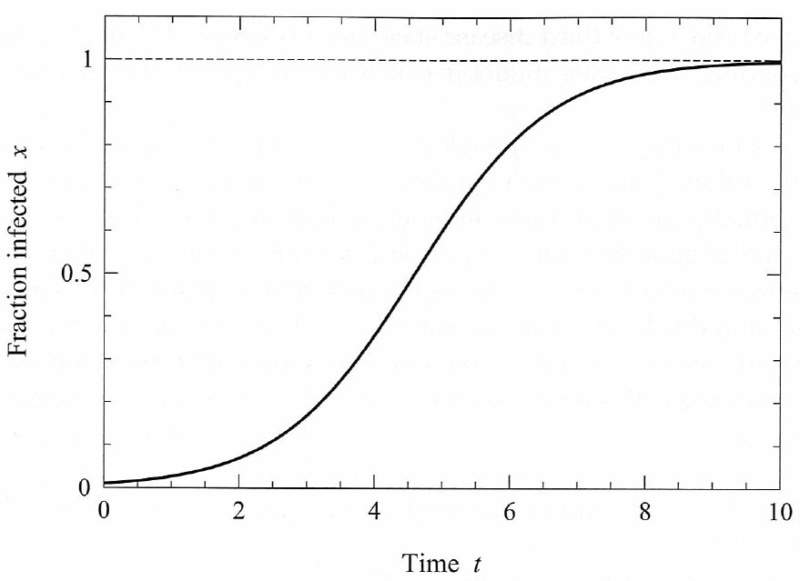
Logistic growth curve

Slide 8

17.3 The SIR Model
For many real disease, people recover from infection after a certain time and often retain the immunity their immunity to the disease, so that they cannot catch it again.
To represent this behavior, we need a new state, usually denote R for recovered.
This model is called the susceptible-infected-recovered or SIR model.

Slide 9
The SIR Model
Let s (x and r, respectively) be the probability that a random chosen vertex is in the susceptible (infected and recovered, respectively) state at time t.
Let β be the transmission rate.
Let γ be the recovering rate.

Slide 10
Exponential Recovering Time
Assume that the probability of recovering in any time interval Δ is γΔ.
The probability of still being infected after an interval t is
The probability p(t)dt that the individual remains infected in [0, t] and then recovers in [t, t+dt] is
This is the pdf of an exponential rv.

Slide 11
Exponential recovering time
The time for an individual to recover is exponentially distributed with mean 1/γ.

Slide 12
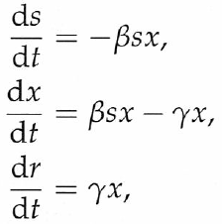



Differential Equations for the SIR Model
The equations for the SIR model are
⇒
Assume that there are no individuals in the recovered state at t = 0.
⇒ where s₀ is the value of s at t = 0.

Slide 13


The SIR Model
⇒
⇒

Slide 14
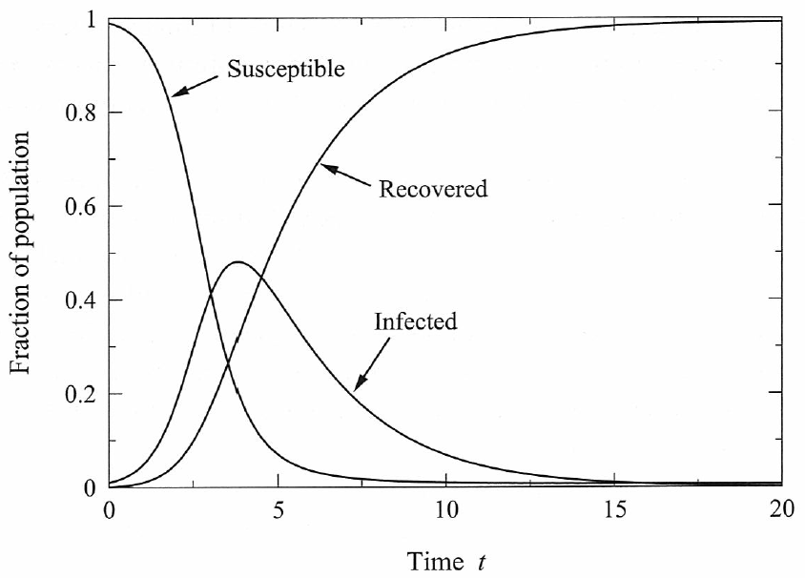
The SIR Model

Slide 15

The SIR Model
Note however that the number of susceptible individuals does not go to zero as t → ∞.
The asymptotic value of r represents the total number of individuals who ever catch the disease during the entire course of the epidemic.
⇒
Assume the disease starts with a small number c individuals and everyone else are in the susceptible state.

Slide 16


The SIR Model
s₀ = 1 – c/n, x₀ = c/n, r₀ = 0.
s₀ → 1 as n → ∞.
⇒
Recall , where S is the size of giant component of a Poisson random graph.
If β ≤ γ (i.e., the transmission rate ≤ recovering rate), then there is no epidemic.
If β > γ, then r > 0.
The point β = γ is called the epidemic transition.

Slide 17

Basic Reproduction Number
Basic Reproduction Number R₀: Consider the spread of disease when it just start out and consider an infected individual, R₀ is the number of additional people infected by that individual before his/her recovery.
R₀ > 1: The disease would grow exponentially.
R₀ < 1: The disease would die out exponentially.
R₀ = 1: The epidemic threshold.
Suppose the recovering time is τ. Then he/she will pass the disease to βτ people on average.

Slide 18
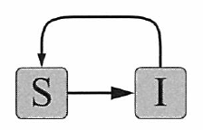
17.4 The SIS Model
For disease that don’t confer immunity on their victims after recovery, or confer limited immunity, so that individuals can be infected more than once.
In the SIS model, there are two states, susceptible and infected, and infected individuals move back into the susceptible state upon recovery.

Slide 19
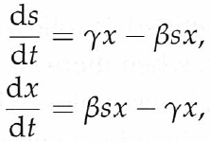




Differential Equations for the SIS Model
The equations for the SIS model are
⇒
⇒ where

Slide 20

Solution
Suppose x₀ → 0 (small number of initial carriers of the disease). Then C ≈ βx₀/(β – γ).
⇒

Slide 21
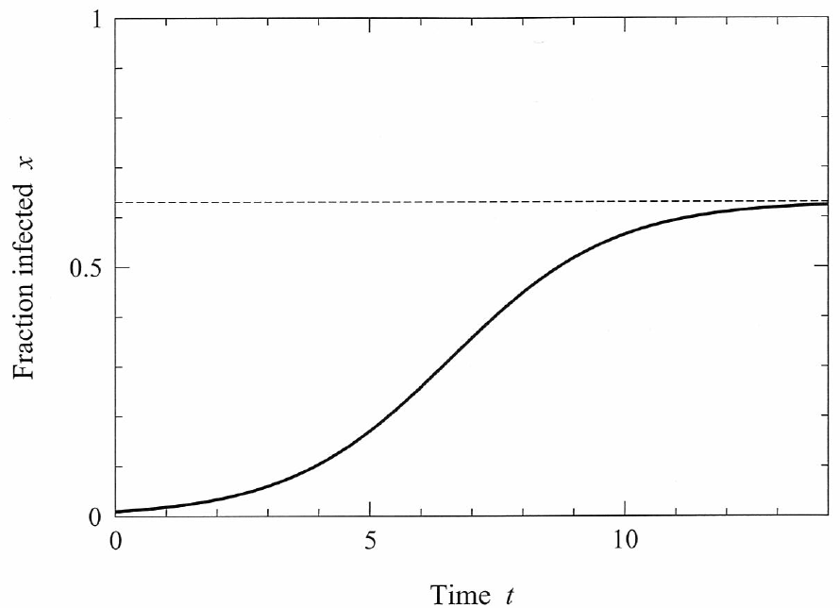
Steady State of the SIS Model
If β >γ and t → ∞ ⇒ dx/dt = 0 ⇒ x = (β – γ)/β.
If β <γ , the disease will die out exponentially.

Slide 22
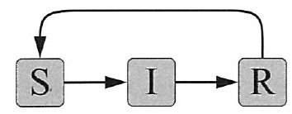
17.5 The SIRS Model
In the SIRS model, individuals recover from infection and gain immunity, but that immunity is only temporary, and after a certain period of time individuals become susceptible again.

Slide 23
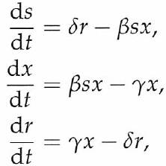

The SIRS Model
δ: the rate at which individuals lose immunity.
The equations for this models are
The SIRS model cannot be solved analytically.

Slide 24
The behaviors depend on the parameters, including behaviors where
  the disease persists in an endemic state,
  where it dies out,
  and where it oscillates between outbreaks and period of remission.

Slide 25
17.6 Epidemic Models on Networks
In fully mixed models, each individual can potentially have contact with each other.
In real world, it is not a good assumption.
The set of a person’s potential contacts can be represented as a network.
Transmission rate β: the probability per unit time that the infection will be transmitted between two individuals connected by an edge.
  The disease transmission time is an exponential random variable with mean 1/ β.
Not that this transmission rate is not equivalent to β in the full mixed models.

Slide 26
17.7 Late-Time Properties of Epidemics on Networks
Late-time properties = steady state (t → ∞).
As t → ∞, the disease will spread from every initial carrier to infect all vertices in the component. If there are only one single infected carrier, just one component will be infected.
If an outbreak starts from the giant component, then we will have a large epidemic.
A randomly chosen vertex is in the giant component with probability S.
Calculating the size of small component gives us the information about the size of out break (if they start from a small component).

Slide 27

17.8 Late-Time Properties of the SIR Model
β: transmission rate.
τ: infectiousness time.
  For simplicity, assume that τ is a constant.
The probability φ that the disease is transmitted is
This is the probability that the time needed to transmit the disease is less than or equal to the time that the individual remains infected.

Slide 28
Bond Percolation
The trick developed by Mollison and Grassberger: Let φ be the probability that an edge is present and 1−φ be the probability that an edge is removed.
This is just the ordinary bond percolation process.

Slide 29

SIR Model and the Configuration Model
Consider an SIR epidemic process taking place on a configuration model network with degree distribution p_{k}.
Let q_{k} be the excess degree distribution.
Let u be the probability that a vertex is not connected to the giant cluster via a specific one of its neighbor.
This happens if
  the edge is not present
  or the edge is present but the vertex in the other end is not connected to the giant component.
⇒

Slide 30



SIR Model and the Configuration Model
⇒
If βτ exceeds this value, then there is a possibility of an epidemic.
If there are only one single infected carrier, the probability is S.

Slide 31
Example: Poisson Degree Distribution
g₀(z) = g₁(z) = e^{c(z − 1)}
φ_{c} = 1/c ⇒ βτ = ln c/(c−1)
u = 1 − φ + φ e^{c(u − 1)}, S = 1 − e^{c(u − 1)}
⇒ 1 − u = φ (1 − e^{c(u − 1)}) = φS
⇒ S = 1 − e^{−cφS}
This equation is similar to r = 1 − e^{−βr/γ} for the fully mixed model.
It is possible to show that there is a direct correspondence between the fully mixed model and the Poisson random graph model.

Slide 32
Example: Power Law Degree Distribution
2<α<3 ⇒ ⟨k²⟩ = ∞ ⇒ φ_{c} = 0.
With positive probability, there is an epidemic no matter how small the transition rate is.
As we shown before, the size of the giant component decreases faster than linear with φ.
In particular, the size of the giant component can be very small.

Slide 33
17.10 Time-dependent Properties of the SI Model
Time-independent properties = transient behavior.
s_{i}(t): the probability that vertex i is susceptible at time t.
x_{i}(t): the probability that vertex i is infected at time t.
Let A be the adjacency matrix.

Slide 34



Coupled Nonlinear Differential Equations
s_{i} and x_{i} obey the following equations:
These differential equations cannot be solved in closed form in general.
  One considers the early time behavior and linearizes the equations.

Slide 35



Time-dependent Properties of the SI Model
Initial condition: x_{i} = c/n, s_{i} = 1 – c/n.
s₀ → 1, x_{i} → 0 as n → ∞.
⇒ (linearization)
or where x is the vector with elements x_{i}.
Let κ₁ ≥ κ₂ ≥ … ≥ κ_{n} be the eigenvalues of A.
Let v_{r} be the eigenvector of A with corresponding eigenvalue κ_{r}.
We can write x as a linear combination:

Slide 36





Time-dependent Properties of the SI Model
⇒
⇒
⇒
⇒
Eigenvector centrality is a crude measure of the probability of early infection a vertex in the SI model.

Slide 37
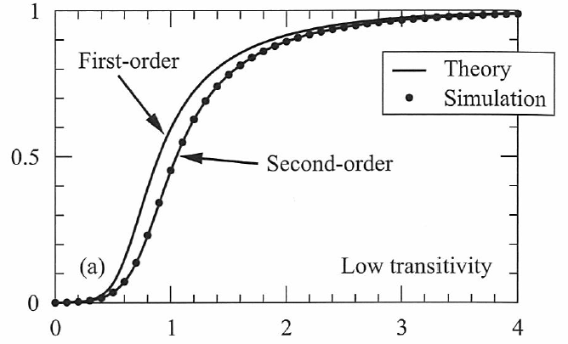
Numerical Integration of the Differential Equations
Numerical
integration
x(t)
time

Slide 38
Disagreement of the Numerical Integration and Simulation Results
The product of s_{i} and x_{j} means that we have implicitly assumed that
  the event that vertex i is susceptible and
  the event that vertex j is infected
  are independent.
They are clearly not, since they are connected by an edge.

Slide 39




17.10.1 Pair Approximations (Moment Closure Method)
The true equation is
is an approximation to the true equation in which we assume that
However, s_{i} and x_{i} are not independent random variables.
One needs to derive an equation for ⟨s_{i} x_{j}⟩:

Slide 40
Pair Approximations
We can approximate the three-variable averages with appropriate combinations of one- and two-variable averages.
This process is called moment closure.
Idea: assumption by conditional independent.
If A_{jk} = 1, assume the state of k to be independent of the state of i
i
k
j

Slide 41
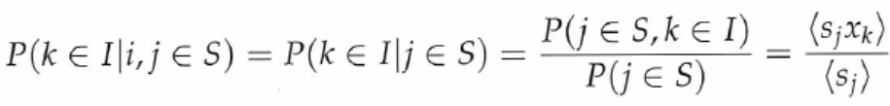

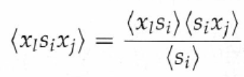
The above two equations imply that
Similarly,
l
i
j

Slide 42
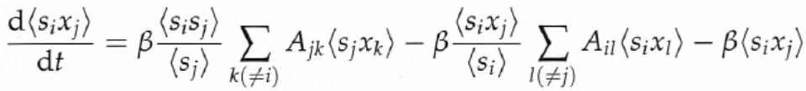
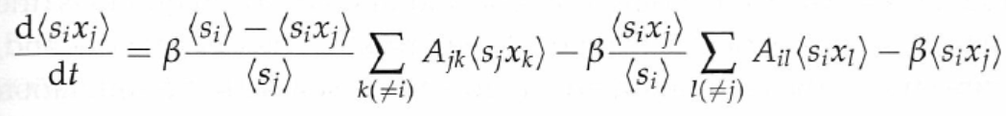

It still contains a new term ⟨s_{i}s_{j}⟩
But, this term can be rewritten as
The equation becomes
This equation can be simplified
Define p_{ij} to be the conditional probability that j is infected given that i is not:

Slide 43
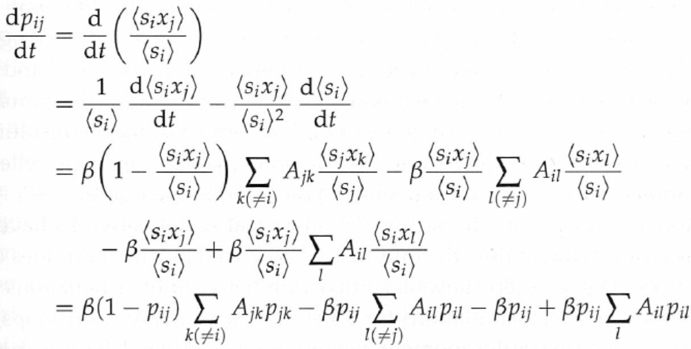
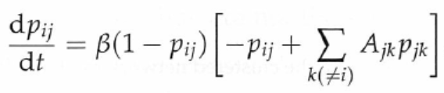
All but one of the terms in the two sums cancel out, leaving a simple equation:

Slide 44
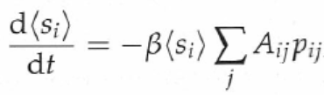
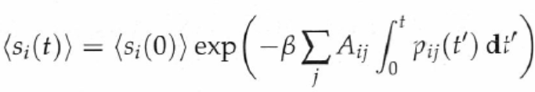
The above equation can be rewritten in terms of p_{ij}:
The solution is

Slide 45
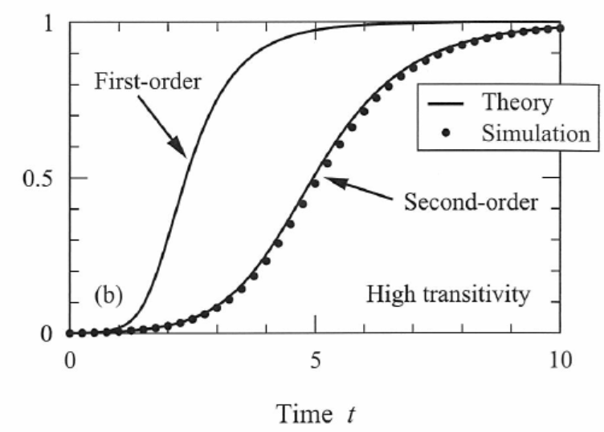
Pair approximation

Slide 46
Pair approximations work well for tree-like networks.
A configuration model is essentially a tree-like network.
For networks with a lot of short loops, this approximation may not work well.
i
k
j

Slide 47
17.10.2 Degree-based Approximation for SI Models
Consider a configuration model in which a disease is spreading.
As before, we focus on outbreaks taking place in the giant component.
This method was pioneered by Pastor-Satorras and coworkers.
It assumes that all vertices of the same degree have the same probability of infection at any time.
  This may not be a realistic assumption, but it allows an elegant analysis.

Slide 48
Let s_{k}(t) and x_{k}(t) be the probabilities that a vertex of degree k is susceptible or infected at time t.
Now consider a susceptible vertex A.
A becomes infected because of one of its neighbors, say vertex B.
Vertex B is infected due to one of its neighbors.
  These neighbors must not be A, since A is not infected.
  The probability that B is infected depends on the excess degree distribution.
A
B
S
I

Slide 49

Consider the probability that A becomes infected between time t and t+dt.
A must catch the disease from one of its neighbors.
The probability that B is infected is x_{k} where k is the excess degree of B.
The probability v(t) that a neighbor is infected is
A
B
S
F
The probability of transmission from a given neighbor is βv(t)dt.

Slide 50


The probability of transmission from any neighbor is βkv(t)dt, where k is the degree of vertex A.
Since we require A be susceptive, with probability s_{k}(t), the rate of change of probability is
One can integrate the equation to get the solution

Slide 51



The solution is of the form
Writing x_{k}=1-s_{k} and substituting the equation in the red box into the equation in the blue box, we get

Slide 52

To derive a differential equation for u(t), substitute the equation in the red box into the equation in the blue box and get
This is a straightforward equation that can be solved by integration.

Slide 53
Some Long Time and Short Time Properties
From the definition of u(t), u(0)=1.
v(t) is positive and non-decreasing, the above equation implies that u(t) always decreases and tends to 0 when t is large.

Slide 54


At long times, the above equation becomes the following equation
Hence, u(t) decays exponentially as
For networks with very small p₁, u(t) is approximately equal to exp(-βt), independent of the network structure.

Slide 55




At short times, substitute u(t)=1-ε in the above equation and get
The solution is
Equivalently,

Slide 56
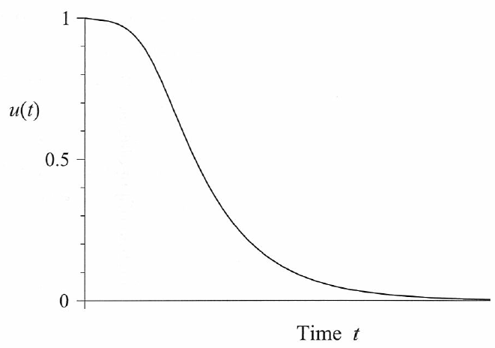
Given the long time and short time behaviors and the fact that u(t) is decreasing, u(t) looks like the following figure

Slide 57

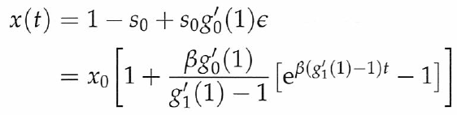
The short time behavior of x(t) can be studied by substituting u(t)=1-ε into the following equation
By , we have
Note that is a measure of how fast the network branches as we move away from the vertex where the disease starts.
  This quantity and β control the spreading rate of the disease initially.

